Slide 1
ARSP Update Remedial Investigation Comments Summary
June 14, 2018

Slide 2
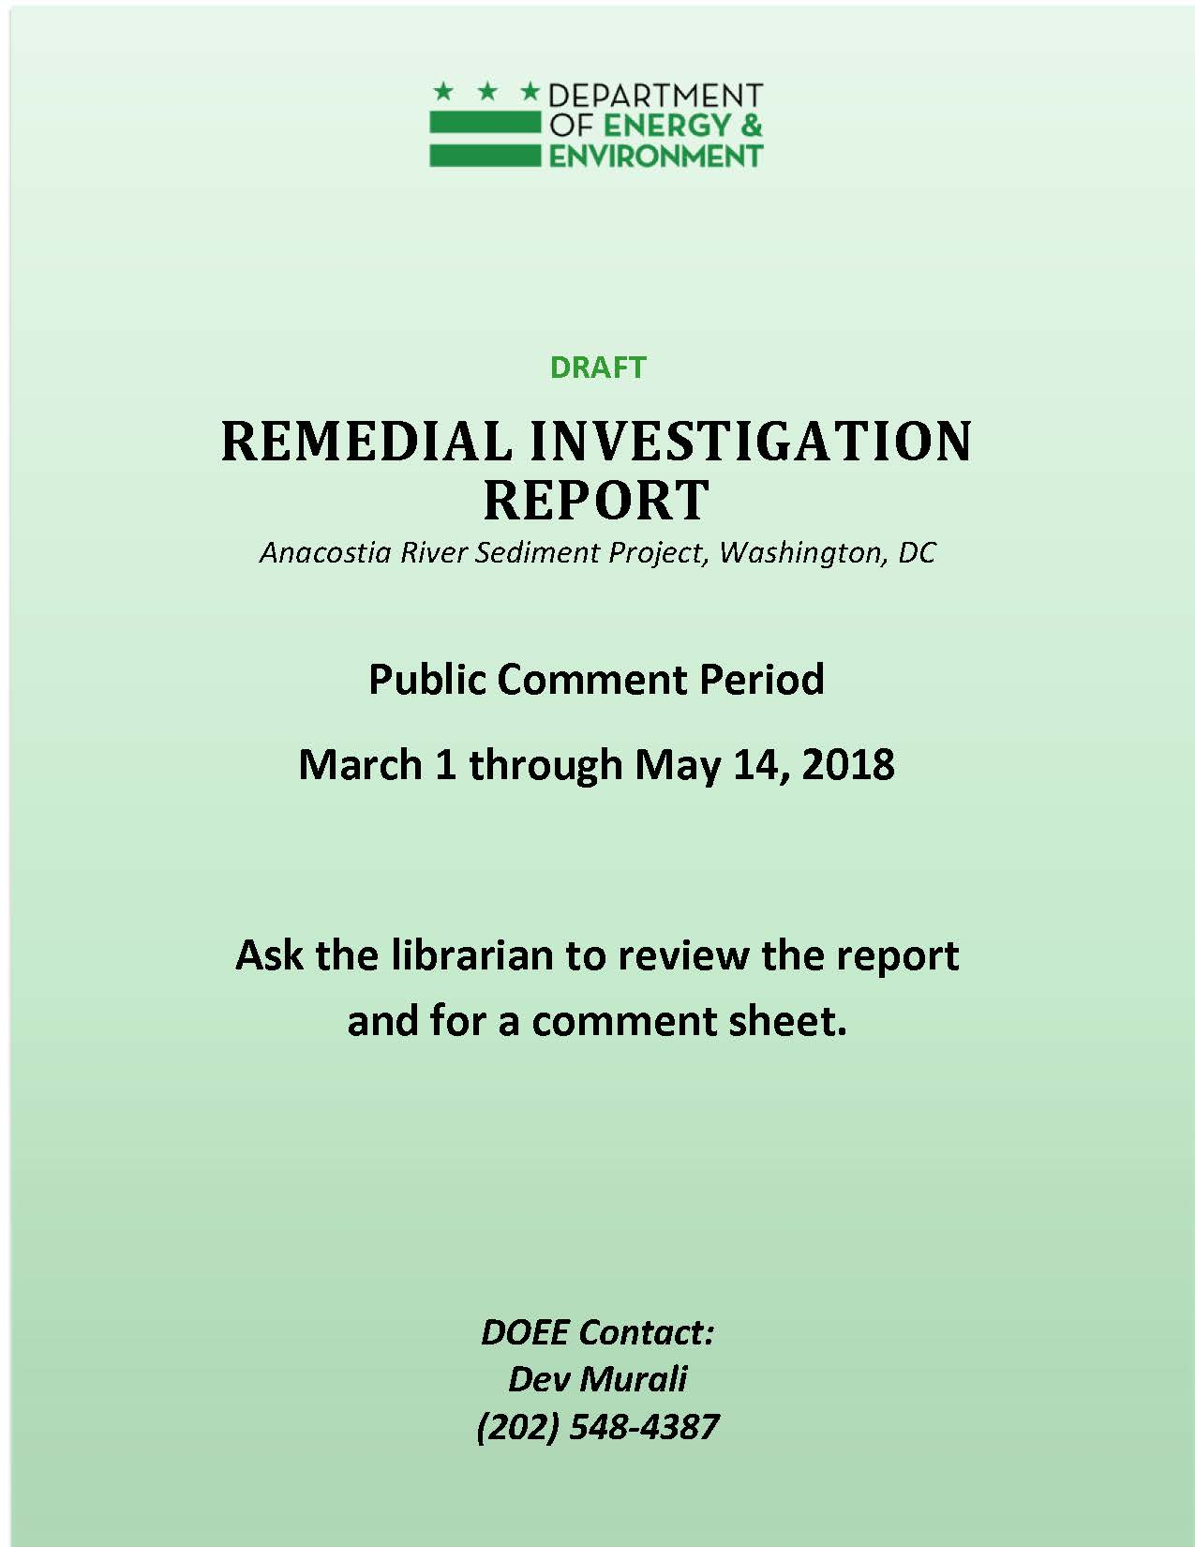
Public Comment Summary
Remedial Investigation Report Public Comment Period- March 31 through May 14
557 comments received on RI, HHRA, and ERA
18 organizations commented including:
Non-governmental organizations
Government agencies
Commercial entities
1 Private citizen

Slide 3
Major Comment Themes
Notes:
This graphic is a word cloud we created from the comments themselves. We excluded a few common words- like Anacostia River, but the larger the word the more frequently it occurred.

Slide 4
Major Comment Themes
Evaluate Fish data: quantity, type, location, use of existing studies
Consider background alternatives
Explain geostatistical kriging and its relationship to field data
Explore the causes of toxicity to biota
Quantify the contribution of surface water, groundwater, and suspended sediments from tributaries, CSSs, and MS4s
Characterize proximate potential sources
Discuss forensics data collected as part of the RI
Provide rationale for the size and species of fish included in the HHRA and selection of the fish consumption rates
Define actionable risk and hazard conditions
Notes:
Fish data: Sufficient # of samples, types of data from different sources
Fish data: types of fish collected, use of different studies, location of fish, Potomac vs Anacostia fish
Background: The RI states that “a realistic and implementable cleanup strategy for the Anacostia River requires accurate estimations of background concentrations that reflect the urban environment of the study area.” Background for surface sediments. Background for fish.
Geostatistical kriging: its accuracy as related to field data
Toxicity: Most comments related to ecological risk assessment
Hazard quotients (HQs)

Slide 5
Next Steps
Review and respond to RI comments
Incorporate comments into RI, FS, and appendices
Release Draft FS for public comment in late Summer
Final RI in early Autumn
Preliminary Assessment
Site Investigation
Remedial Investigation
Feasibility Study
Proposed Plan
Record of Decision
Remedial Design
Remedial Action
Long-term Management

