Slide 1
ONGOING INPUTS OF PERSISTENT ORGANIC POLLUTANTS TO THE ANACOSTIA RIVER
Nathalie Lombard, Mandar Bokare, Varapapa Thodpanich, Sam Magee,
Upal Ghosh
Department of Chemical, Biochemical, and Environmental Engineering, UMBC
Study partners:
USFWS
USGS
UMCP
DOEE
Presentation to the
Leadership Council for a Cleaner Anacostia River
September 13, 2018
10:00 am – noon

Slide 2
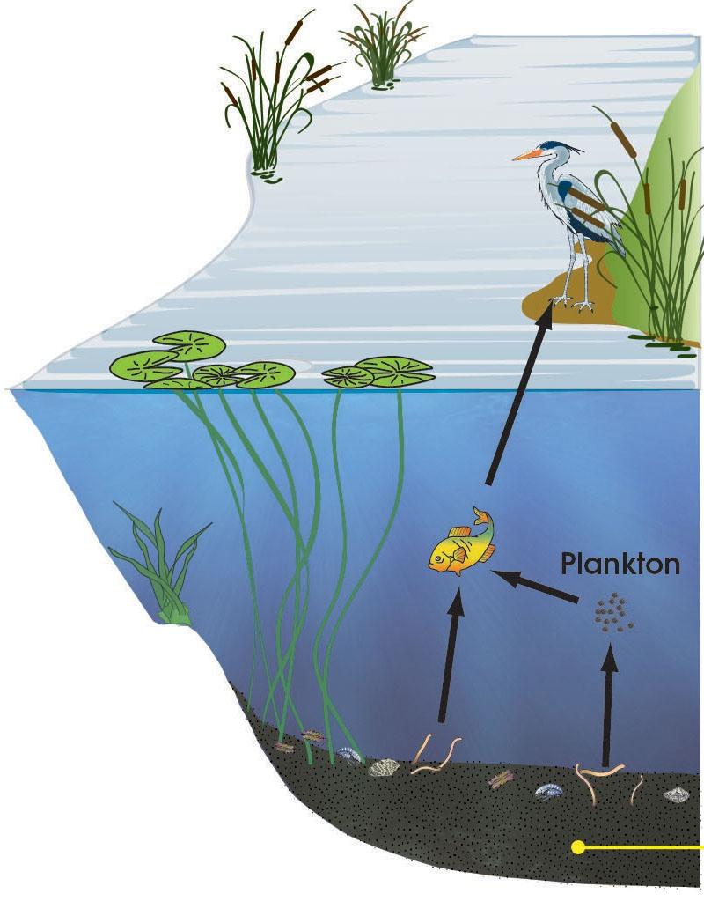
ONGOING INPUTS OF POLLUTANTS
Air-water exchange
Upstream inputs
Human exposure from water through food chain
Dissolved concentrations control exposure
Contributions to water from:
1) Bed sediments
2) Inputs from tributaries and outfalls
3) Air-water exchange
Ongoing inputs difficult to characterize
Using state of the art monitoring approaches to quantify loads
Complements RI with new data on loads
Coordinated with USGS effort to characterize stormflow inputs
Tributary
inputs
CSO
Flux from sediment
Outflow

Slide 3
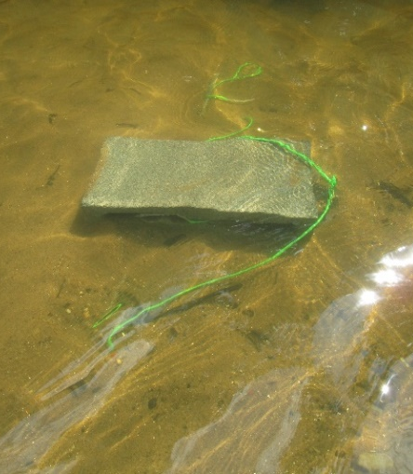
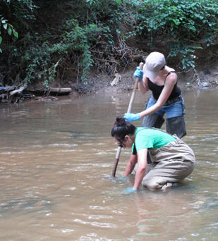
PASSIVE SAMPLING FOR MEASURING FREELY DISSOLVED CONCENTRATIONS
Hydrophobic chemicals partition between water and solid phases
Concentration in polymer can be related to the concentration in water
Performance reference compounds used to correct for non-equilibrium
New approach: Integrative passive sampling

Slide 4
SAMPLING LOCATIONS
Water sampler
Air sampler
Mussel

Slide 5
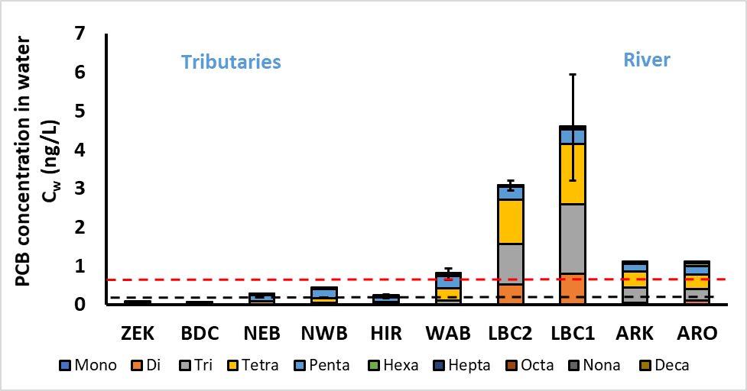
PCBs in water
Dissolved PCBs exceed 10⁻⁵ cancer risk at several tributaries and in Anacostia River
Dissolved PCBs in LBC higher than in Anacostia River
Deployment July-September 2016
Provisional data subject to change

Slide 6
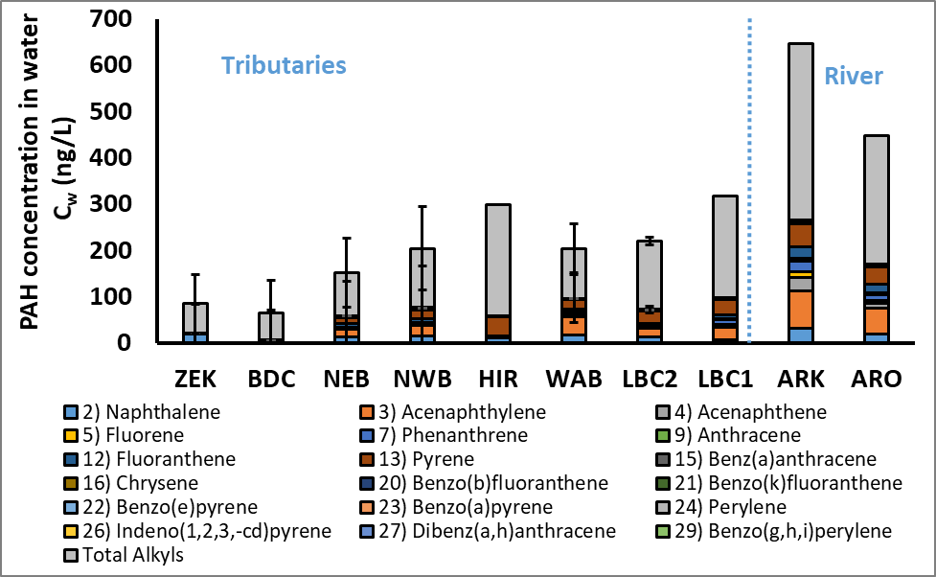
PAHs in water
Deployment July-September 2016
Provisional data subject to change

Slide 7
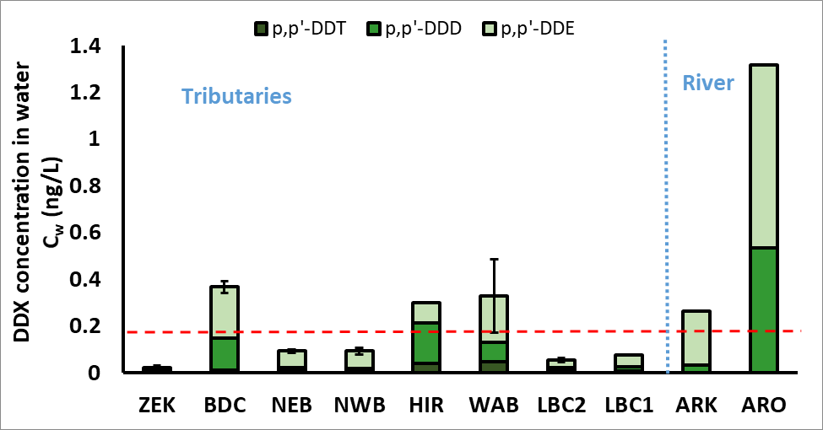
DDx in water
Deployment July-September 2016
Provisional data subject to change

Slide 8
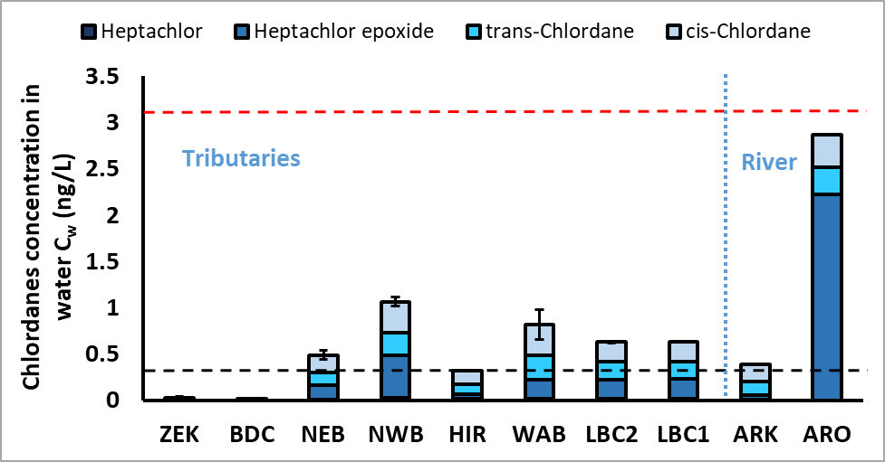
Chlordanes in water
Deployment July-September 2016
Provisional data subject to change

Slide 9
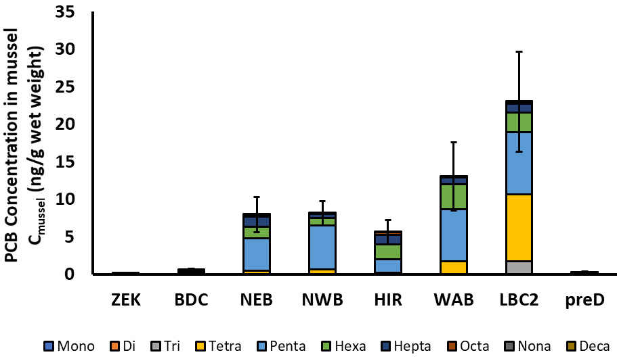
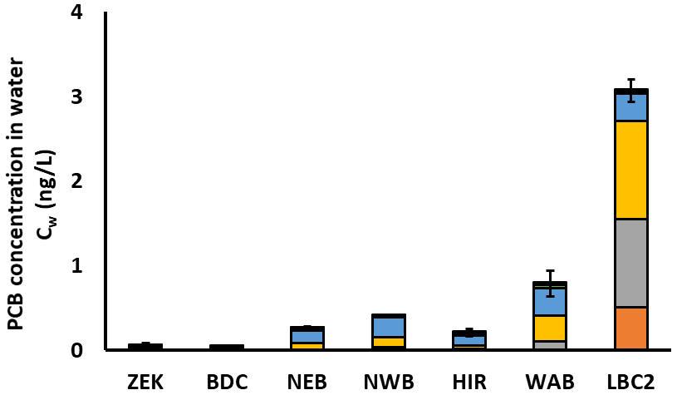
PCBs in mussels compared to surface water
PCB bioaccumulation in deployed mussels reflect differences in freely dissolved concentration in surface water

Slide 10
PCBs in suspended sediments
Anacostia River
Stormflow sediments cleaner than most of the bed sediments in Anacostia River
Baseflow sediments have higher PCBs than Stormflow sediments
Provisional data subject to change

Slide 11
Freely dissolved PCBs during baseflow and stormflow
Dissolved PCBs generally much higher during baseflow compared to stormflow
Exceptions: HIR and LBC
Dissolved PCBs in LBC higher than in Anacostia River
Provisional data subject to change

Slide 12
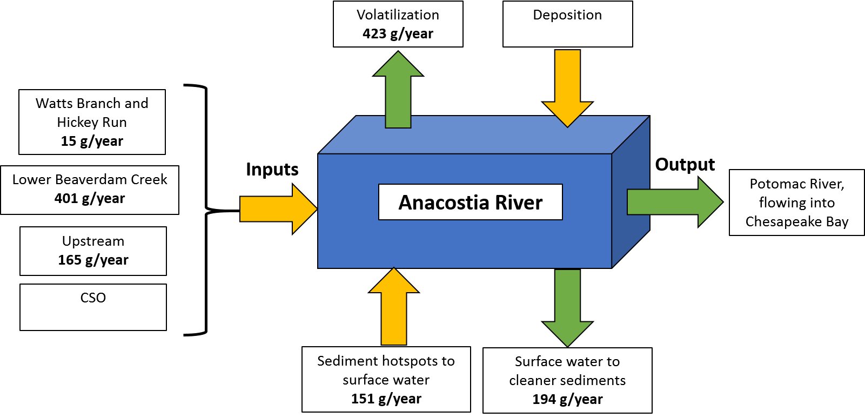
Measured total PCB loads for the Anacostia River
Net PCB volatilization out from water
Lower Beaverdam Creek contributes the highest total PCB load
PCB source from sediment hot-spots and sink into cleaner sediments
Provisional data subject to change

Slide 13
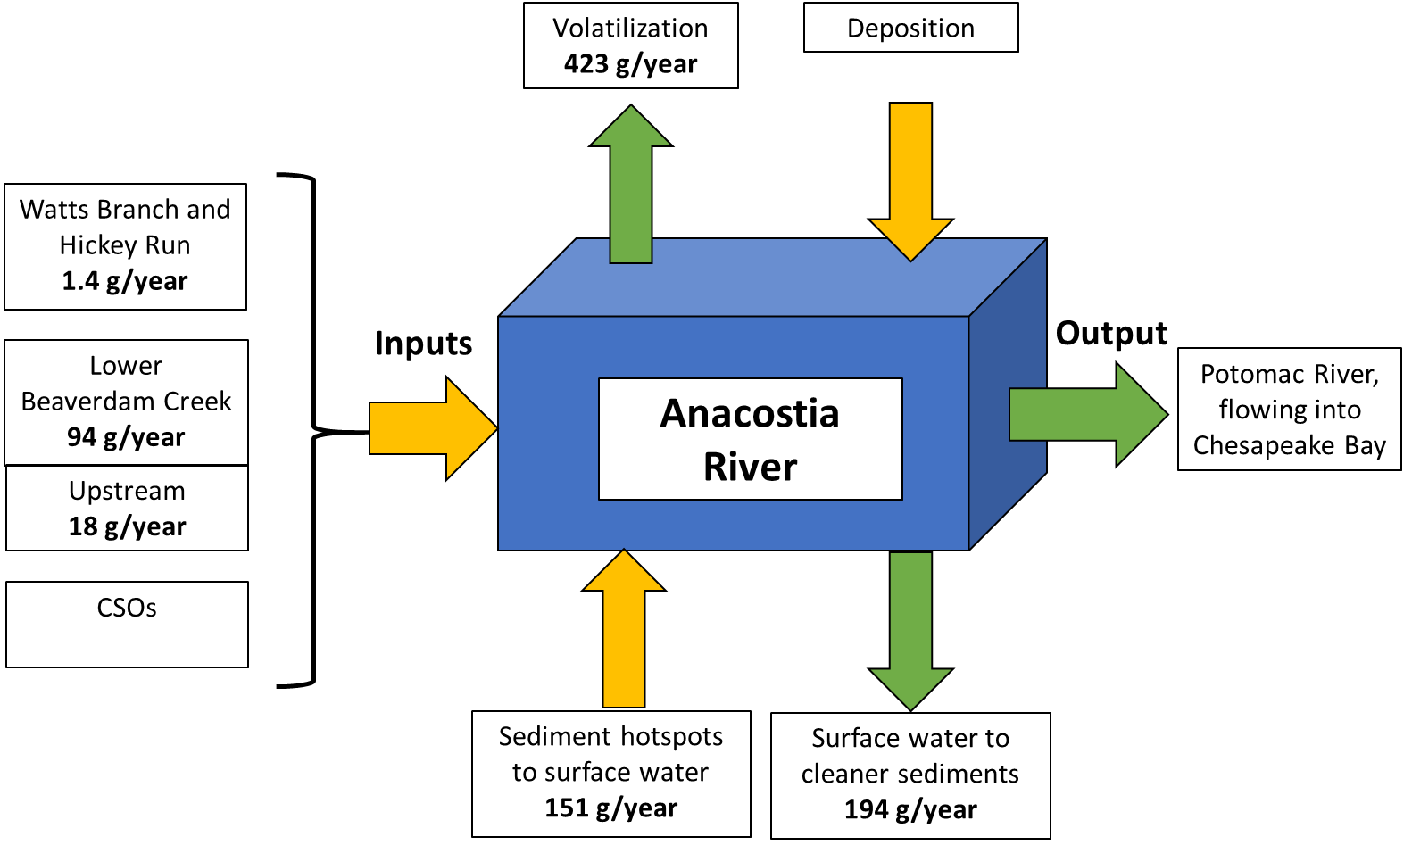
Measured dissolved PCB loads for the Anacostia River
Sediment hotspots and Lower Beaverdam Creek contribute most of the dissolved PCBs
Provisional data subject to change

Slide 14
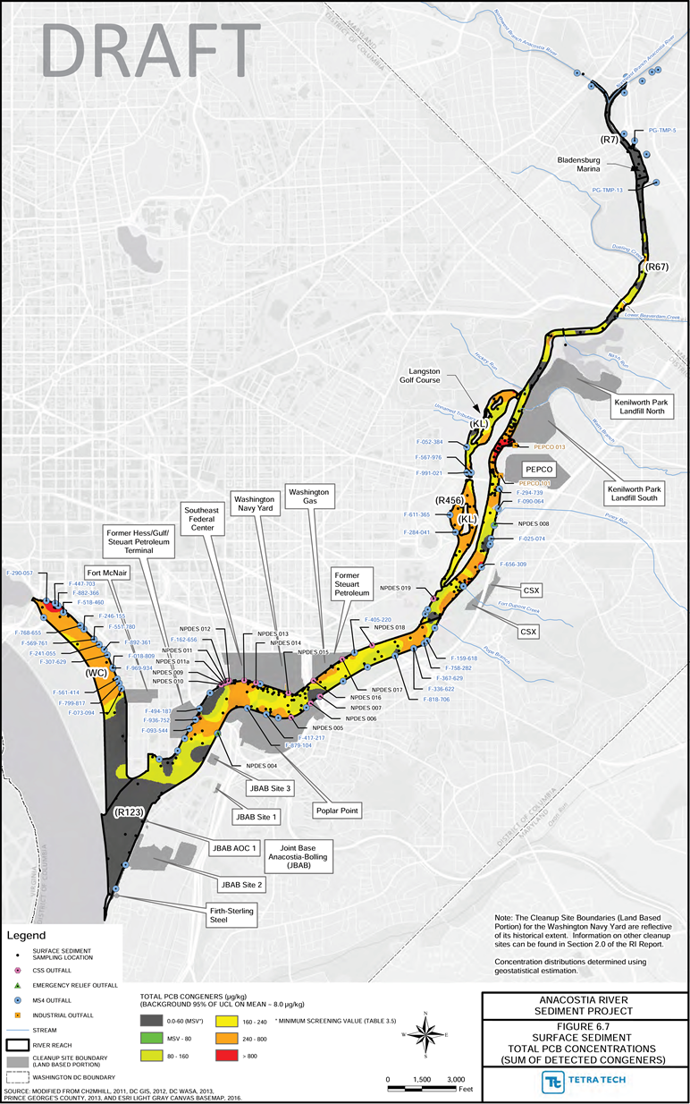
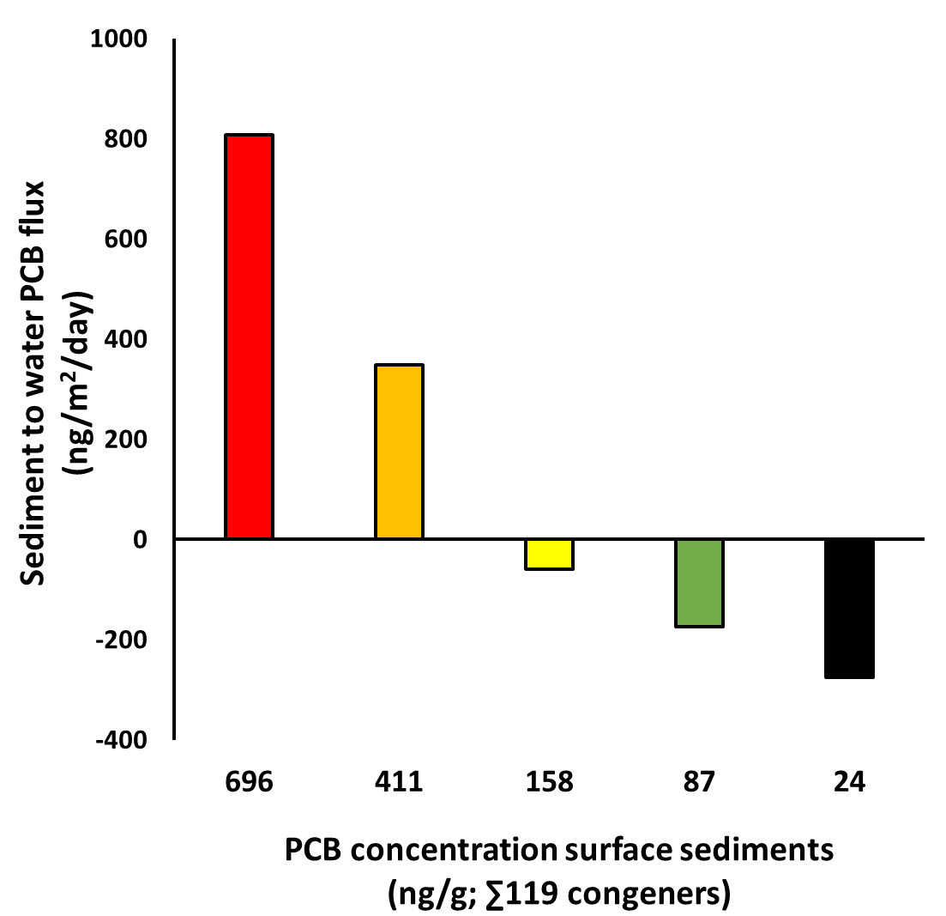
Sediment-water flux of PCBs
Above 200 ng/g, sediments act as a source of PCBs to the water column
Below 200 ng/g, sediments act as sinks of PCBs
Provisional data subject to change

Slide 15
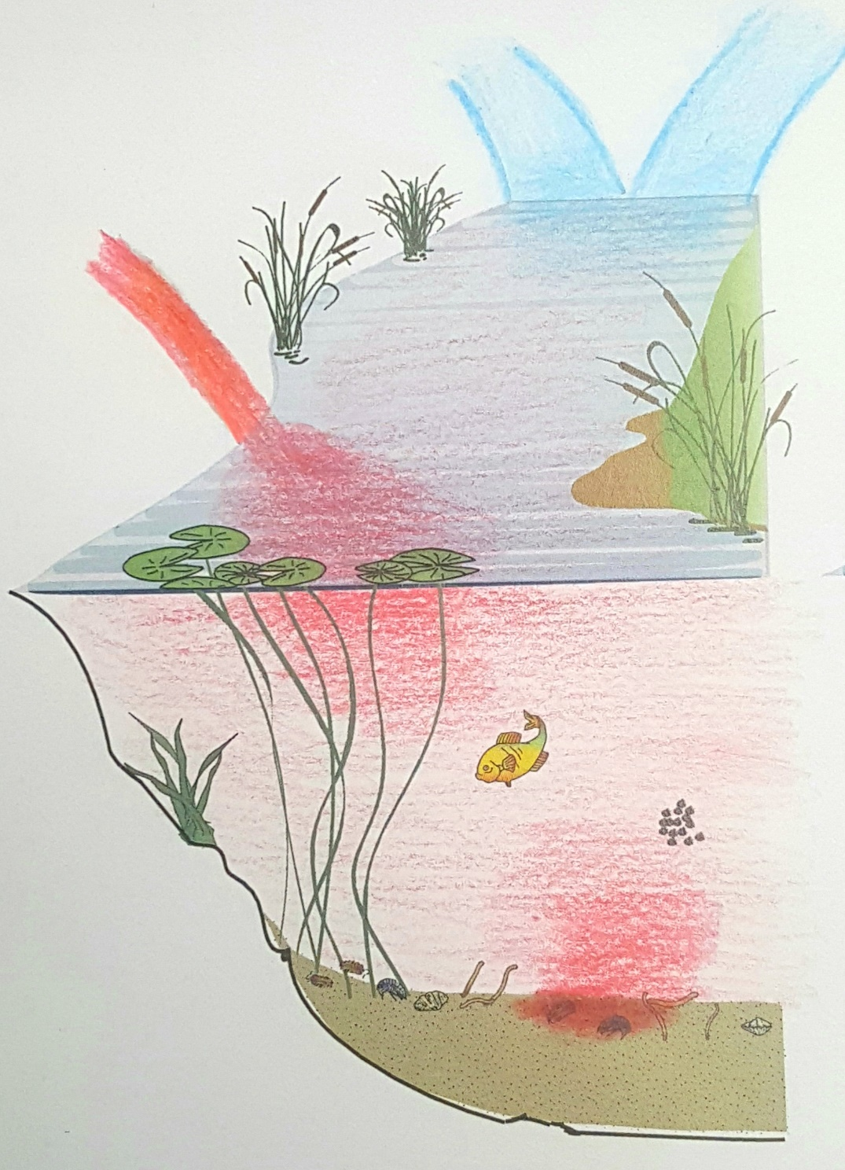
Initial Conclusions
NWB
NEB
New data using latest technology for measuring low levels of pollutants in air and water
Main sources of dissolved PCBs in river:
Lower Beaverdam Creek
Sediment Hot-Spots
Water concentration exceedances for human cancer risk
High concentration in water causing net PCB volatilization from Anacostia River
Pollutant concentrations in mussel reflect concentrations in water
Storm sediments cleaner than river sediments
LBC
Hot spot
Questions?
Provisional data subject to change

