Slide 1
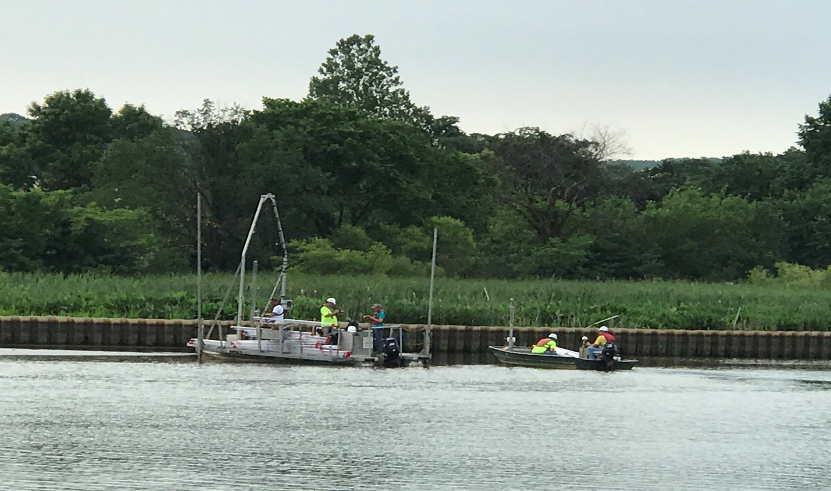
RI/FS Updates at Pepco Benning Road Facility

Slide 2
Consent Decree (CD)
In December 2011, the DC federal district court approved a Consent Decree between Pepco and District documenting Pepco's agreement to conduct an environmental evaluation (known as a Remedial Investigation and Feasibility Study or RI/FS) of the Benning Road facility and the adjacent portion of the Anacostia River
DOEE on behalf of District is overseeing Pepco’s work and will solicit and consider public input and comments during the RI/FS process.
In 2012, Pepco and DOEE organized and convened the Community Advisory Group (CAG) comprised of representatives from local community groups, environmental organizations, and ANCs. Pepco and DOEE attend monthly CAG meetings and provide regular updates regarding the project and also respond to community questions and concerns.
Pepco and DOEE organize and convene public meetings during various milestones such as public comment period for Draft RI Report, Draft RI/FS work plan.

Slide 3
Benning Road Facility
The Benning Road Facility occupies 77 acres in the northeast of the District of Columbia.
Pepco has operated the facility for more than 100 years. The facility is currently home to the Benning Service Center.
Benning Service Center supports Pepco's operation of its
electric transmission and distribution system.
The facility used to have a generating station. The generating station was shut down in June 2012 and associated structures were demolished by May 2015.
Benning Road Facility is separated from the Anacostia River by
a bike trail, National Park Service Kenilworth Maintenance
Yard, the DC Department of Public Works Solid Waste Transfer
Facility, and the Anacostia Avenue.

Slide 4
RI Study Area
The RI Study Area per the CD consists of a “Landside” component focused on the Site itself, and a “Waterside” component focused on the shoreline and sediments in the segment of the River adjacent to and immediately downstream of the Site.

Slide 5
Target Contaminants for RI
Polychlorinated Biphenyls (PCBs)-manmade chemicals used in a variety of industries and products including electrical equipment, banned in 1979
Polycyclic Aromatic Hydrocarbons (PAHs)-widespread in the
environment – some natural, most come from fossil fuels
Volatile Organic Compounds (VOCs) include solvents such as perchloroethylene (PCE) and gasoline components
Semi-volatile Organic Compounds (SVOCs)-include PAHs and
other organic compounds that do not evaporate easily
Pesticides-manmade chemicals used for insect and pest control
Dioxins – products of incomplete combustion
Metals – present naturally in the environment and in many materials used in industrial, commercial and residential products

Slide 6
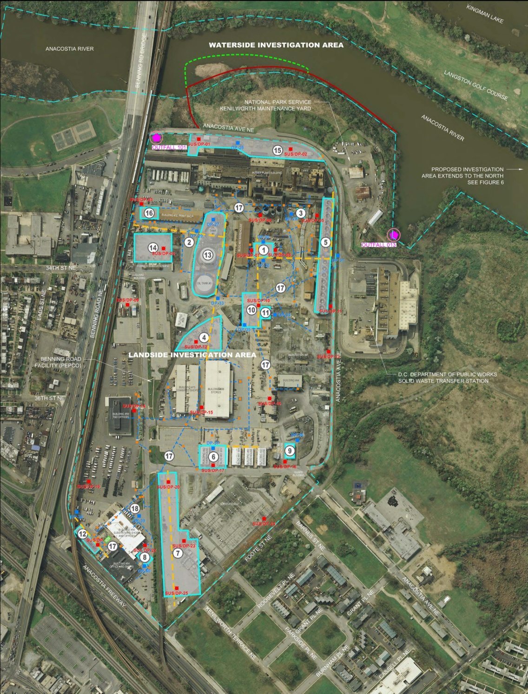
Waterside Investigation
RI Phase I Landside Target Areas
Target Areas

Slide 7
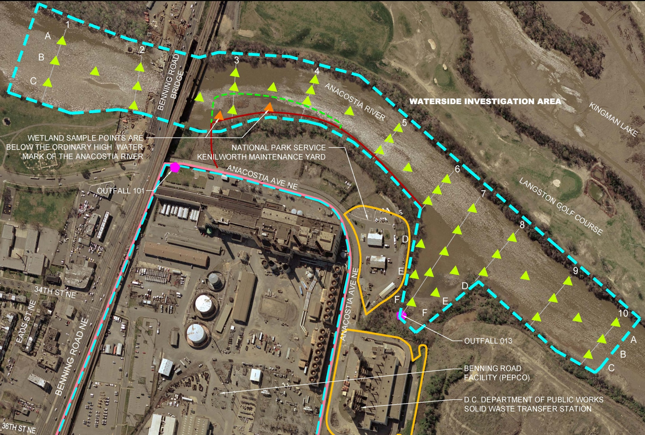
Phase I Waterside Sample Locations

Slide 8
RI Phase I Field Activities Completed (Jan 2013 –Dec 2014)
Environmental Medium | Number of Samples
Landside
Surface Soil | 25
Subsurface Soil | 142
Beneath and around Cooling Tower soil | 207
Groundwater from borings | 48
Storm Drains | 8 water and 4 residue
Geotechnical Borings | 5
Groundwater from monitoring wells | 30
Waterside
Surface water | 20
Surface Sediments | 56
Subsurface Sediments | 208

Slide 9
Phase I RI Data Gaps
The RI Phase I activities completed to date resulted in a preliminary characterization of potential Site-related impacts on Landside and Waterside portions of the Study Area. Some of the data gaps that are currently being investigated are as follows:
Within Landside investigation area for soil, elevated constituents include:
PCBs, Dioxin, metals, and PAHs
Within Landside investigation area for groundwater, elevated constituents include:
PCBs, Dioxin, PAHs, MTBE, and PCE
Within Waterside investigation area:
Elevated sediment concentrations of PCBs in the cove of the River at Outfall 013.
Notes:
Cooling tower basin – around 8000 ton of soil removed
Former sludge dewatering area, former coal piles, former transformer area, former railroad switch yard, historical PCB spill areas- salvage yard, storage areas, former fueling island

Slide 10
Phase I RI Data Gaps (continued)
Forensic Analysis: The Draft RI Report completed by Pepco concluded that several contaminants on the Site and in the River sediment are potentially attributable to a variety of off-site sources. Additional forensic sampling is currently conducted to confirm these preliminary findings, define the exact forensic properties of these contaminants, and better differentiate onsite and offsite impacts resulting from site operations from the impacts attributable to urban background.
Expanded Background Investigation: Additional Landside and Waterside data collection is currently being conducted to refine the preliminary background data evaluation and risk assessments.
Notes:
Background : Non-site specific literature values were used in the background evaluation for comparison.

Slide 11
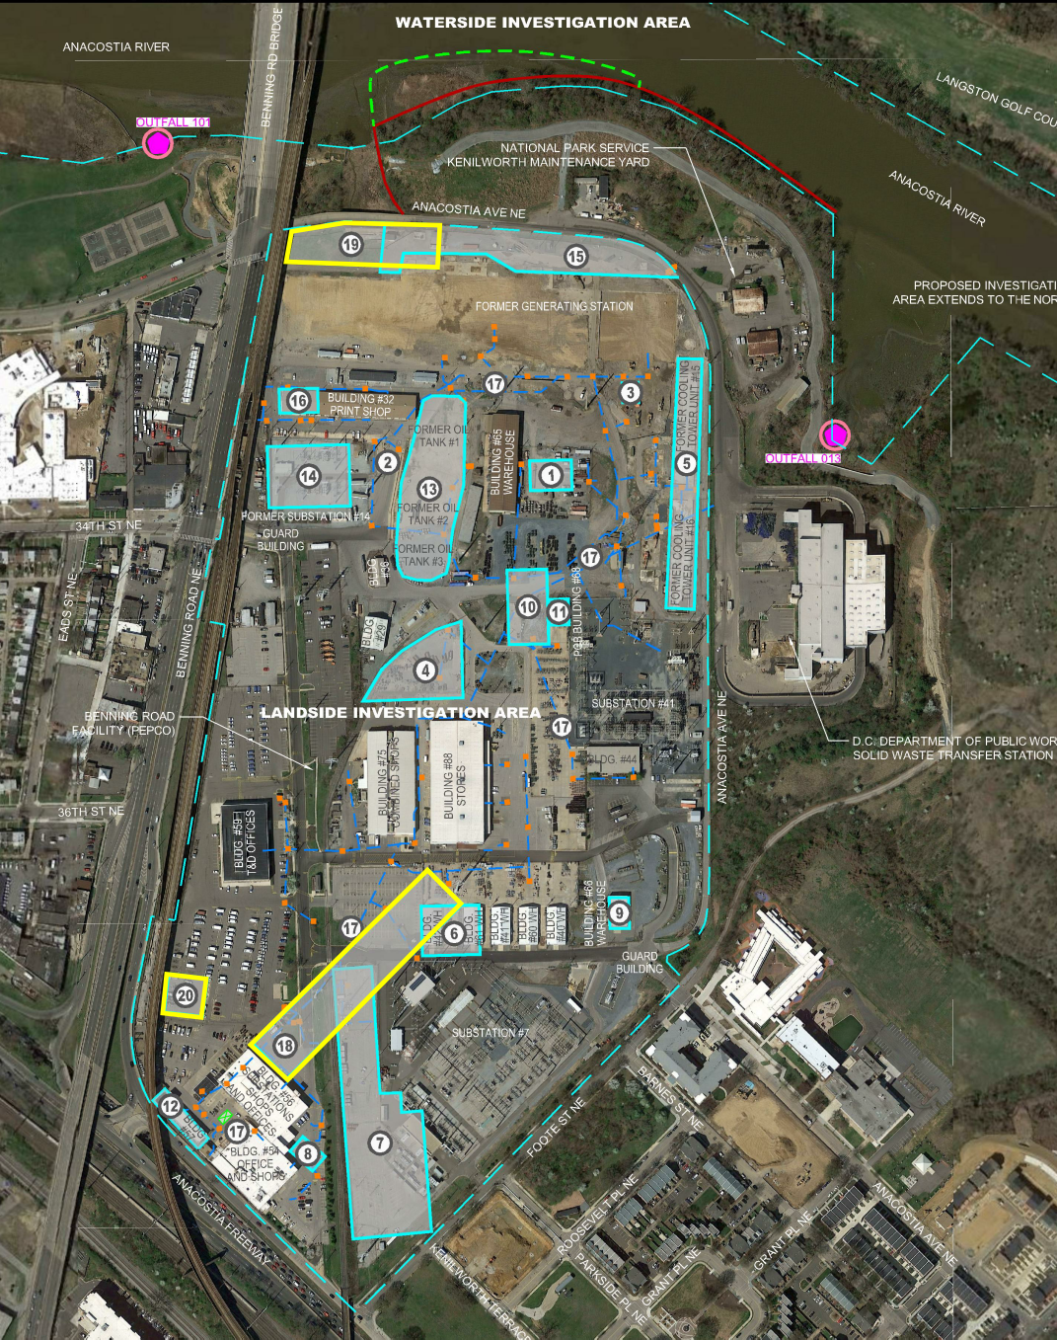
Additional
Landside Target Areas for Phase II Investigation
Original Target Areas
New or Revised Target Areas

Slide 12
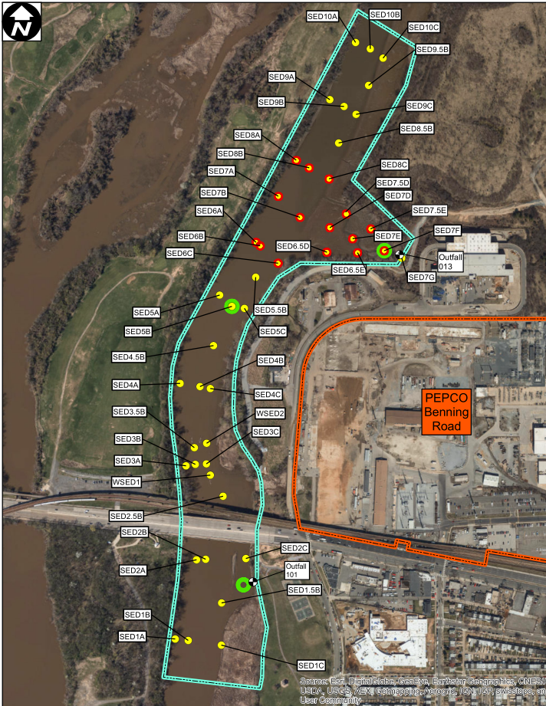
Phase II Waterside Sample locations
Additional Sampling Locations for Biological Testing
Additional Sampling Locations for Sediment Stability Analysis

Slide 13
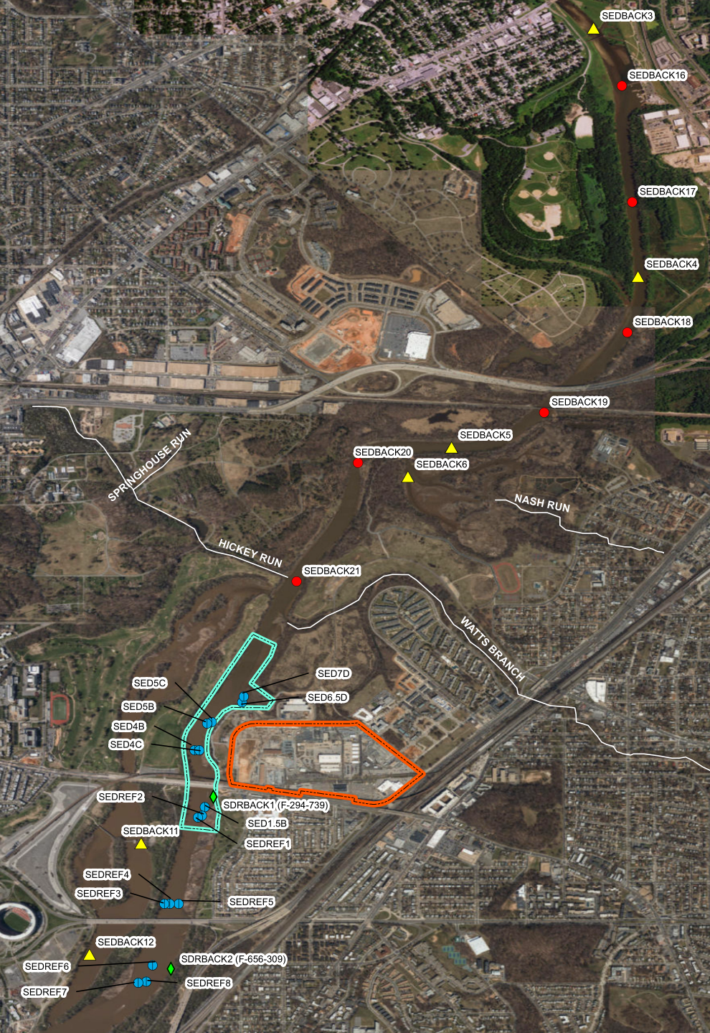
Additional Background and Forensics Sampling Locations
Additional Background Sediment Sampling Locations
Forensics Sediment Sampling Locations

Slide 14
Project Schedule
RI/FS Work plan approved by DOEE (Dec 2012)
RI Phase I Field Investigation (Jan 2013 –Dec 2014)
Draft RI Report for Public Review (Feb 2016)
RI Work plan Addendum (Oct 2016)
RI Phase II Field Investigation (Dec 2016 – Sept 2017)
Draft Final RI Report for Public Review ( Mar 2018)
Final RI Report ( May 2018)
Draft FS Report for Public Review (May 2018)
Final FS Report (July 2018)
Notes:
Permit delays NPS and MD

Slide 15
Current Status & Next Steps
Phase II Field investigations to address landside data gaps commenced in 2016 and are currently in progress.
Phase II Waterside sample collection completed in June 2017. Laboratory analysis and benthic and toxicity studies are in progress.
DOEE and Pepco are currently reviewing site and background sampling results and assessing potential for remaining data gaps.
Pending resolution of remaining data gaps, Pepco will submit a revised RI Report to DOEE for review in January 2018.
Initial planning for the FS is ongoing.

Slide 16
Coordination with Other Projects
Validated waterside (sediment and pore water) data from Pepco RI (Phase 1) has been integrated in the Anacostia River Sediment Project (ARSP) Database. Also, validated ARSP data are shared with other potential environmental cleanup sites (PECSes) on the river including Pepco.
Validated waterside data from Pepco RI (Phase 2) will be incorporated into ARSP database when available.
DOEE is constructing and calibrating a groundwater flow and solute transport model to examine the fate and transport of contaminants of concern within the surficial aquifer proximate to the Anacostia River from Pepco and other PECSes.
Pepco’s riverside FS will be closely coordinated with the river-wide FS portion of the ARSP.

Slide 17
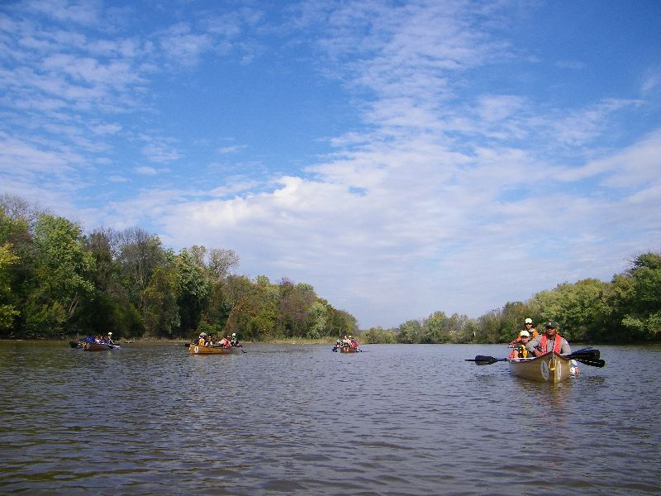
Questions?
Apurva Patil, Remedial Project Manager
202-654-6004
apurva.patil@dc.gov

