Slide 1
Tumor Prevalence in Brown Bullhead in the Anacostia River and Tidal Potomac Watershed: 1992-2016
Fred Pinkney
U.S. Fish and Wildlife Service
Chesapeake Bay Field Office
Annapolis, MD
Presentation to:
Leadership Council for a Cleaner Anacostia River
June 14, 2018

Slide 2
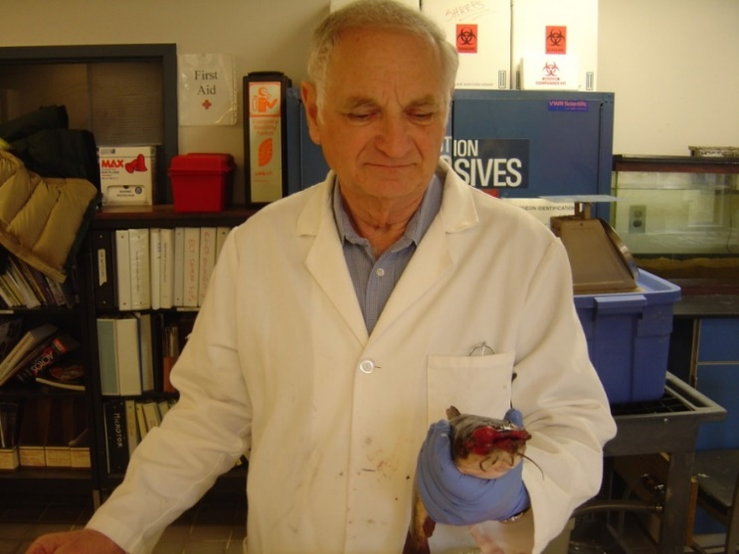
COAUTHORS
John Harshbarger,
George Washington University
Medical Center
Mike Rutter, Penn State - Erie
Peter
Sakaris,
Georgia
Gwinett
College
FUNDING: DC DEPT ENERGY & ENVIRONMENT

Slide 3
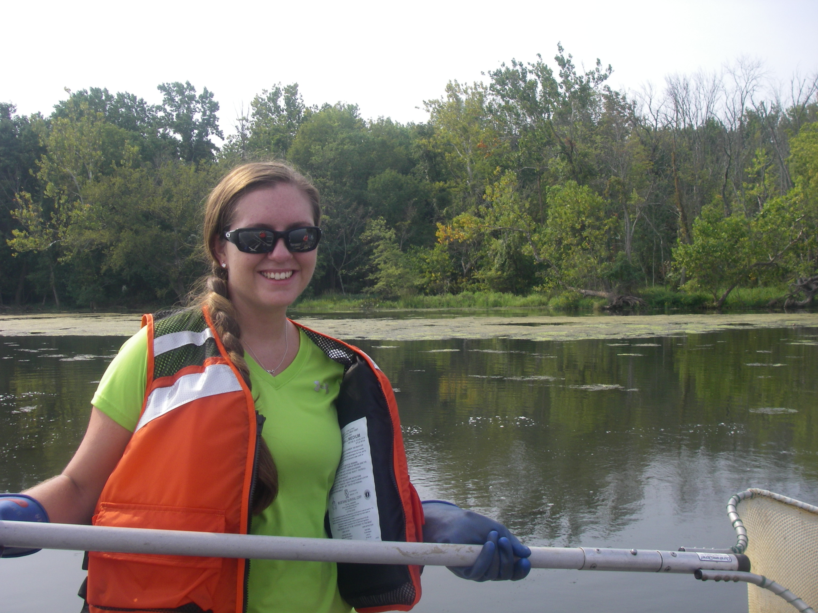
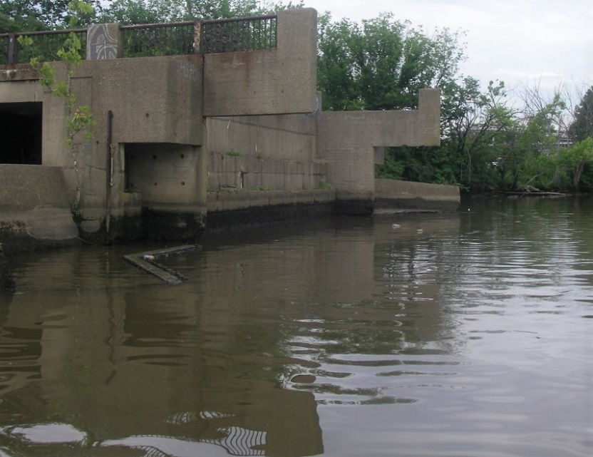
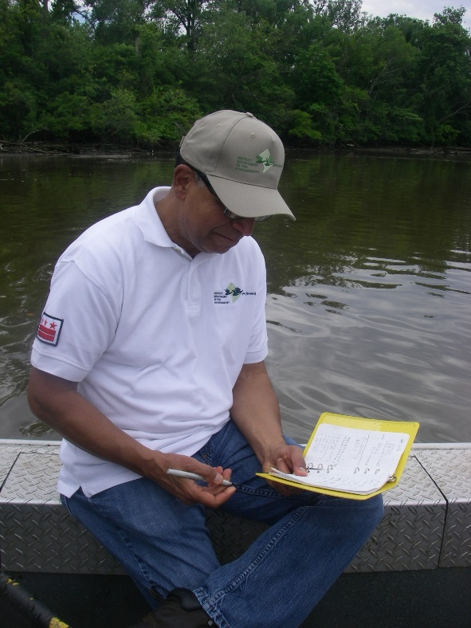
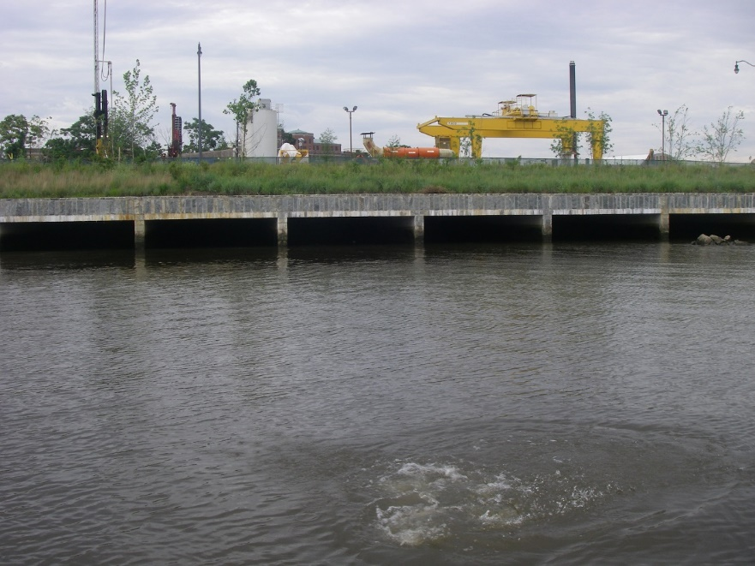

Slide 4
Acknowledgments
Department of Energy & Environment: Dev Murali, Bryan King, Danny Ryan, Eric Thadey, Luke Lyon, and Joe Swann.
USFWS: Steve Minkinnen, Josh Newhard, Mike Mangold, John Gill, Ian Park, and Rachel Harrison.
Funding: DOEE

Slide 5
Background
Cancer-causing chemicals enter rivers, estuaries, and coastal waters and build up in sediments
Some bottom-dwelling fish species develop tumors
Tumor surveys have been used as an indicator of habitat quality and track cleanups: Puget Sound, Great Lakes, Chesapeake Bay

Slide 6
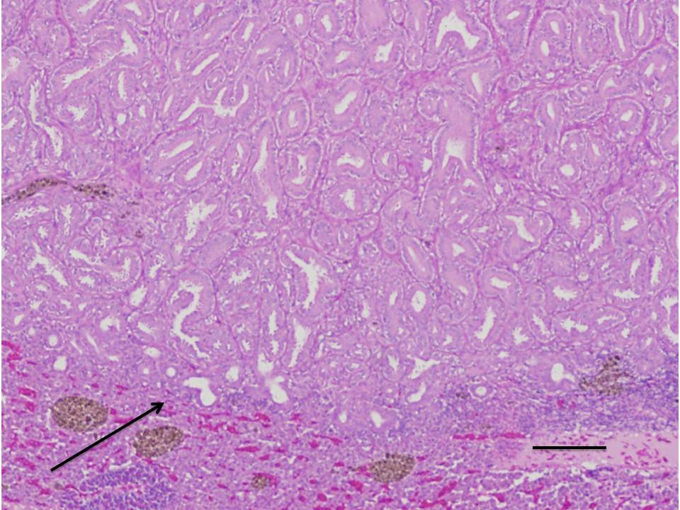
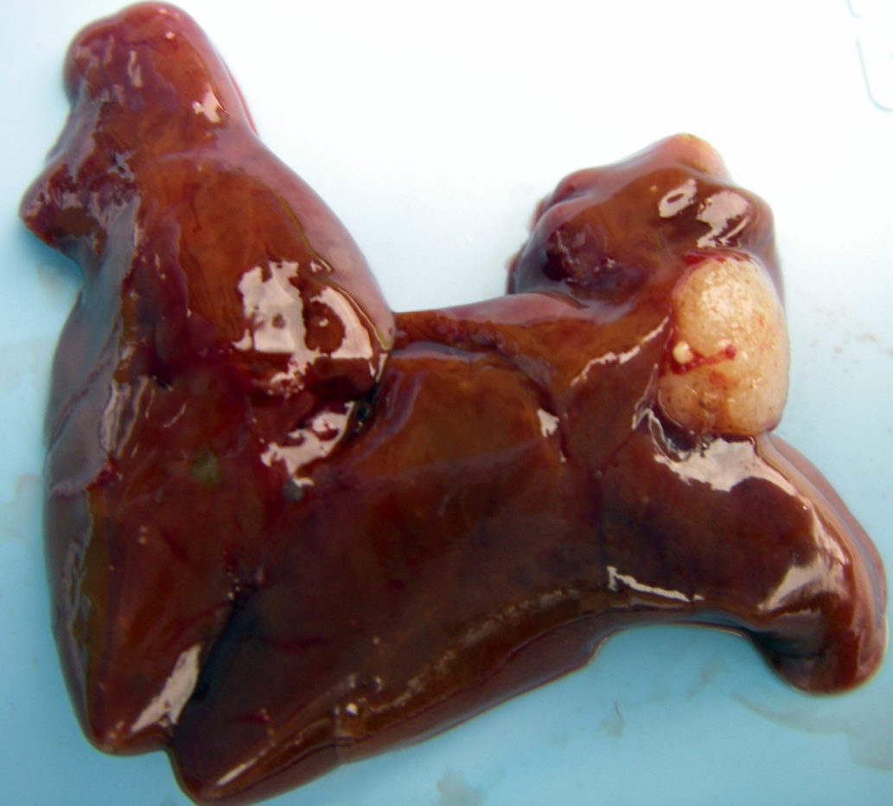
Cholangiocarcinoma
Liver tumors
Hepatocellular carcinoma

Slide 7
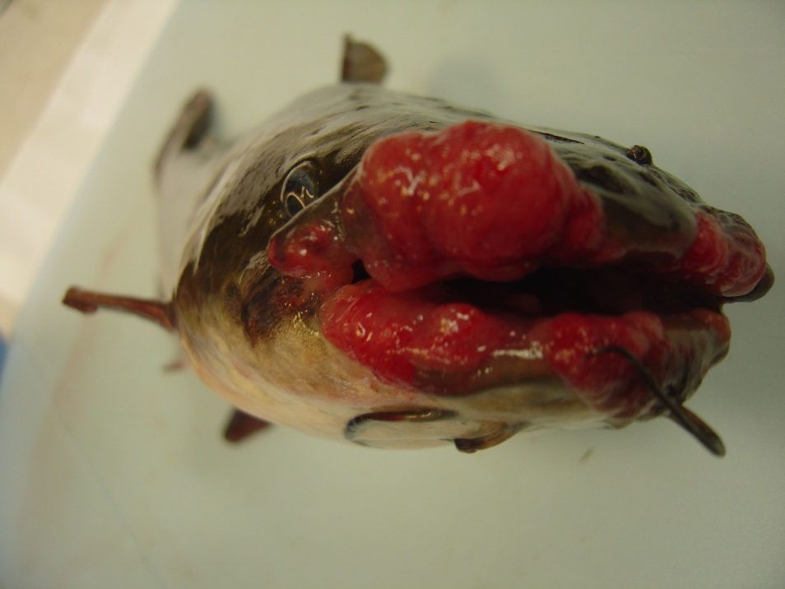
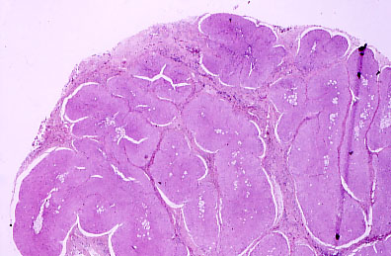
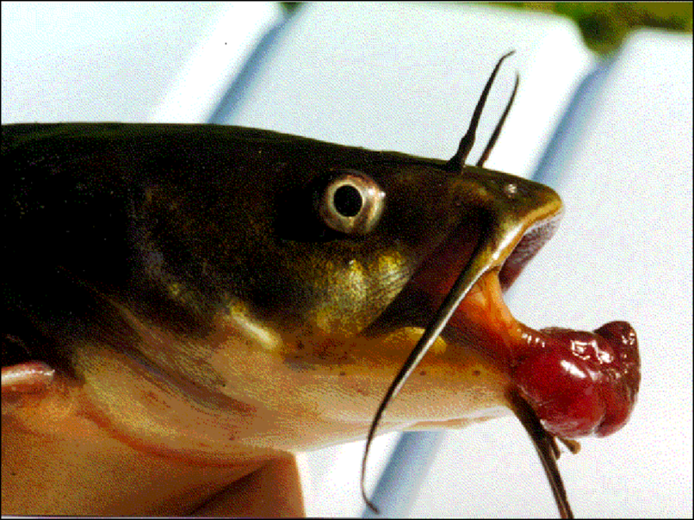
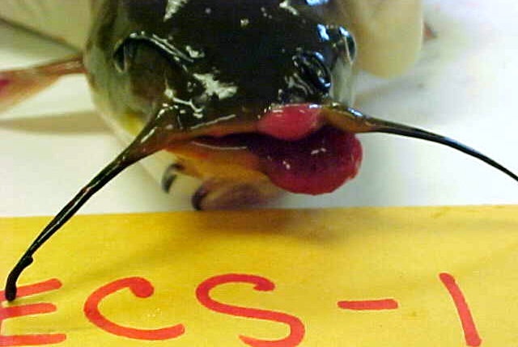
Skin lesions diagnosed as squamous cell
carcinomas,

Slide 8
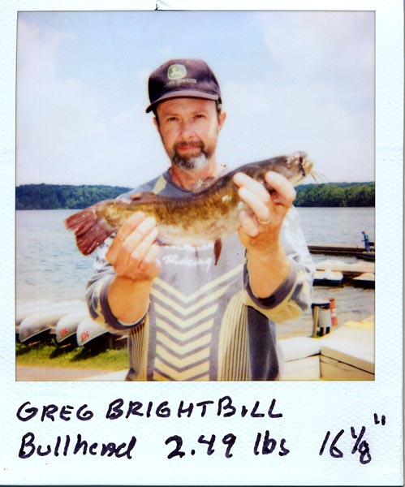
Brown bullhead: ideal species
Bottom feeder
Small home range (2 km in Anacostia)
Great Lakes and Chesapeake Bay tribs up to 8 ppt

Slide 9
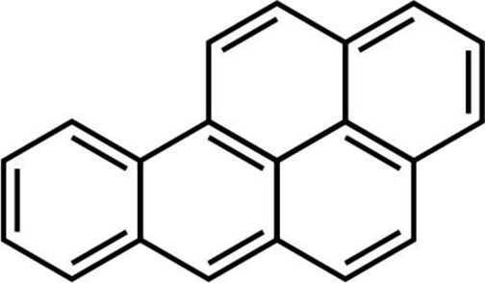
Polynuclear Aromatic Hydrocarbons (PAHs)
Over 100 chemicals
Found in fossil fuels-coal, gas, oil—tar, asphalt, pitch; runoff from roads, car exhaust, leaking oil
Accumulate in sediments
Some compounds cause cancer in humans, rats, mice, fish

Slide 10
Relationship of biomarkers of PAH exposure
Benzo(a)pyrene
Bile metabolites
CYP1A as EROD
Diol epoxide
Mutations
Oncogene activation
DNA adducts
Tumor formation
Repair

Slide 11
Standard DRZ typical
of PAC exposure
Radioactive zone
from additional
class of
compounds
Anacostia River
Tuckahoe River
Schematic
Chromatograms of DNA adducts in brown bullhead livers from Anacostia and Tuckahoe Rivers and schematic. (DRZ= diagonal radioactive zone, PAC= polycyclic aromatic compound).

Slide 12
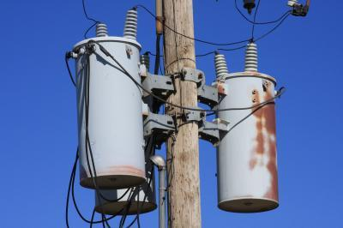
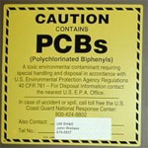
Polychlorinated biphenyls (PCBs): Banned (1979) but still in use
PCB-Contaminated Transformers containing between 50 and 499 ppm
PCB Transformer contains concentrations greater than 500 parts per million (ppm)
Other sources: capacitors, light ballasts, caulks, floor coatings, pigments

Slide 13
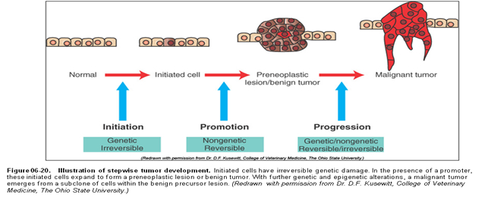
LIVER CARCINOGENESIS IN FISH
PAHs
PCBs,
DDT
DNA adducts

Slide 14
OBJECTIVES: 2014-16 Study
Spatial and temporal analysis
use the 25-year database to identify reference locations; test effects of age, length, sex, and weight
examine links with exposure to PAHs, polychlorinated biphenyls (PCBs), and DDT

Slide 15
Methods
~ 50 brown bullhead > 250 mm per collection
Lab necropsy, aging, pathology
Logistic regression analysis
Sediment chemistry: 2015: 5 samples per location and compare with 2000 data
Interpret fish biomarker and tissue data

Slide 16
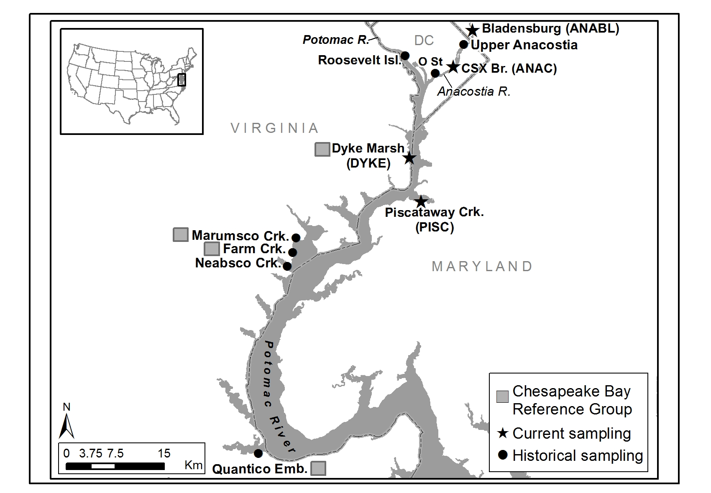

Slide 17
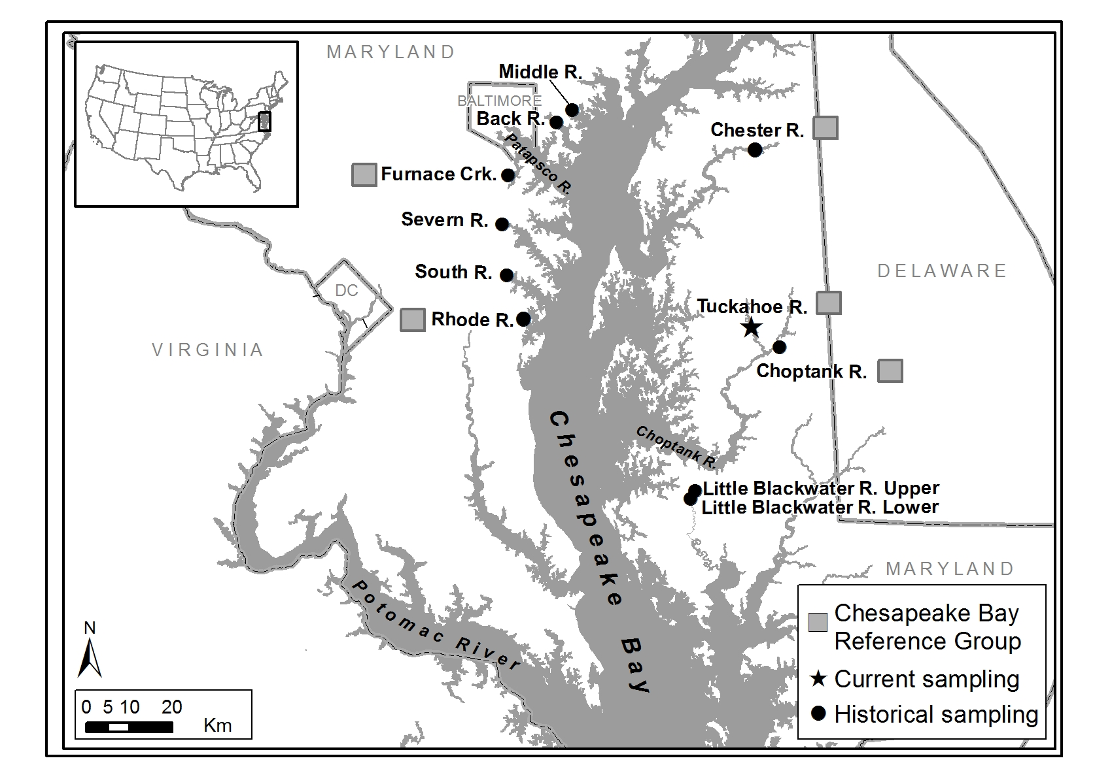

Slide 18
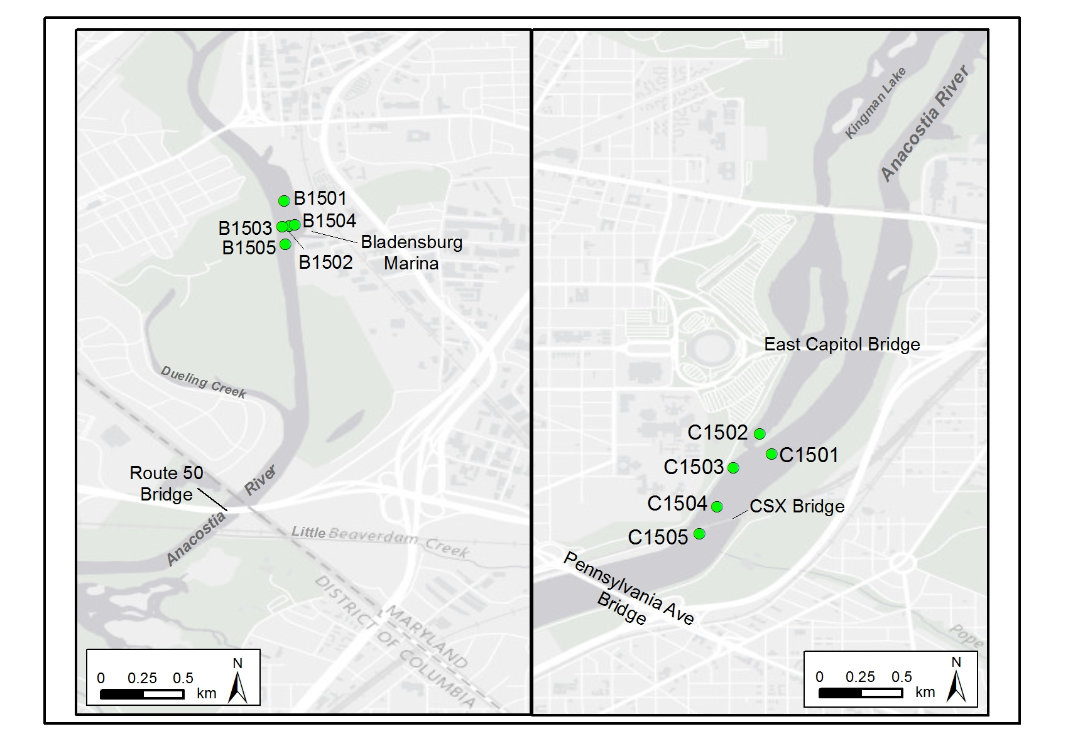
USFWS sediment sampling locations at Bladensburg (ANABL; left) and near the CSX Bridge (ANAC; right).

Slide 19
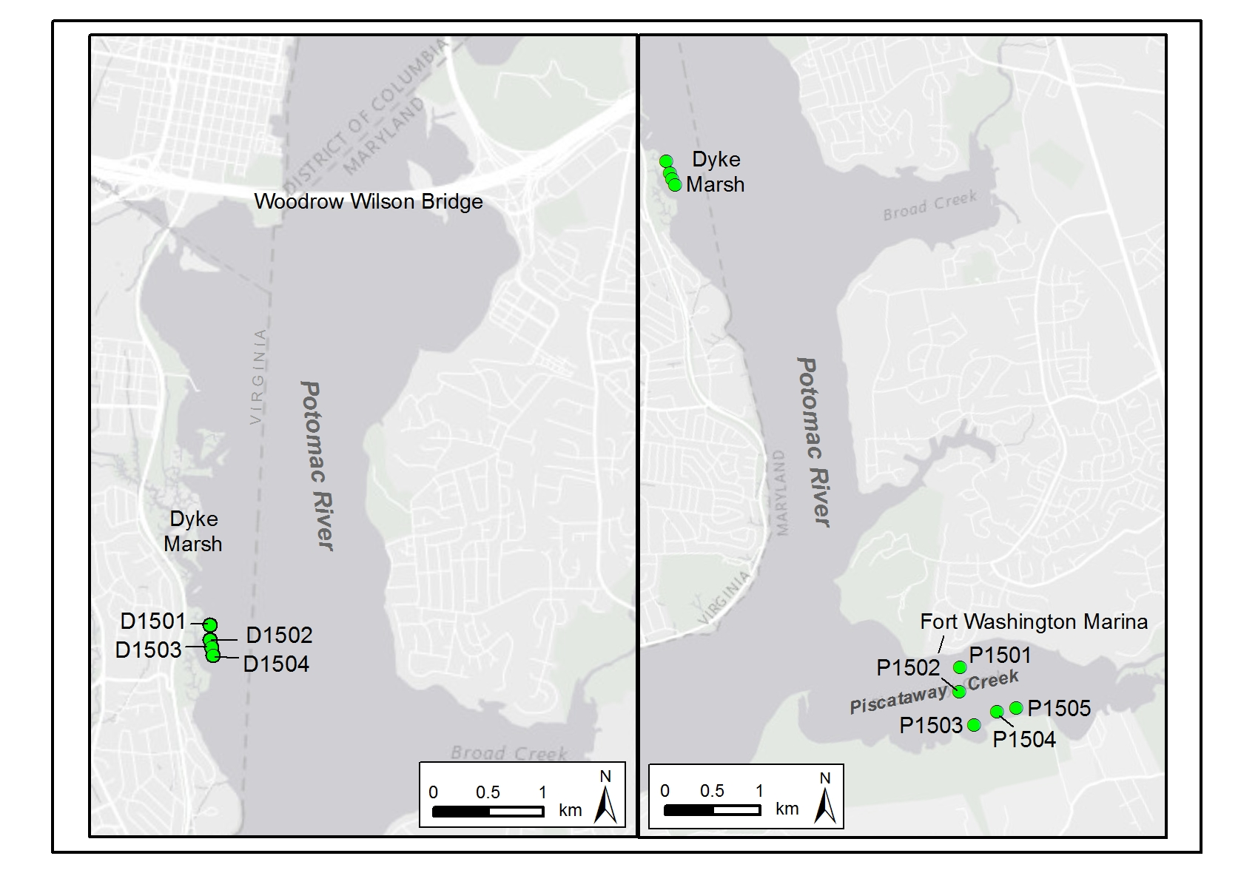
Potomac River showing the USFWS sediment sampling locations at Dyke Marsh (DYKE; left) and Piscataway Creek (PISC; right).

Slide 20
LIVER TUMOR PROBABILITIES: FEMALES

Slide 22
SKIN TUMOR PROBABILITIES: FEMALES

Slide 24
Anacostia Sediments: 2000 vs. 2015
 | ANABL |  |  | ANAC
 | ANS (n=4) | USFWS (n=4) | Statistics | ANS (n=19) | USFWS (n=5) | Statistics
Date | 9/20/2000 | 9/8/2015 |  | 9/20/2000 | 9/8/2015
Total PCBs (ppb) | 99.3±19.0 | 20.7±7.8 | t-test, p<0.001 | 175±79 | 177±47 | t-test, p=0.96
Total chlordane (ppb) | 45.5±9.9 | 55.5±16.1 | t-test, p=0.33 | 54.6 (16.5, 147) | 57.5 (46.4, 60.5) | Mann-Whitney, p=0.91
Total DDT (ppb) | 32.1±11.8 | 17.0±3.8 | t-test, p=0.051 | 59.7±29.5 | 30.7±5.2 | t-test, p=0.02^{c}
Total PAHs (ppm) | 32.2±11.3 | 25.8±10.0 | t-test, p=0.42 | 32.0 (18.3, 108) | 30.5 (27.3, 31.7) | Mann-Whitney, p=0.57
Carc PAH (ppm) | 13.9±4.4 | 7.94±3.12 | t-test, p=0.07 | 12.3 (6.0, 33.8) | 8.85 (8.37, 9.71) | Mann Whitney, p=0.09

Slide 25
Sediment total PAH (ppm)

Slide 26
Why are liver tumors decreasing in the Anacostia bullheads?
PAH exposure
Sediment PAHs from collection areas: 2000 vs. 2015, maybe decreasing, few samples
Fish data: 2-4 fold decrease in PAC-DNA adducts 2000 vs. 2009—small sample size
PCB, DDT exposure
Sediment not consistent decrease: 2000 vs. 2015
Fish tissue data: strong decreases-~6-8 fold

Slide 29
Conclusions
Liver tumors down 4 to 8 fold since 2001in Anacostia bullheads from CSX Bridge area
Skin tumors down 6 to 7 fold in Anacostia bullheads
Anacostia CSX: still 2X background for liver; skin now similar to background
2014-16: Piscataway Creek=Anacostia but Dyke Marsh = background

Slide 30
Recommendations
Monitor tumors on a 5-year cycle to track trends in DC and nearby locations
Use fish tissue and biomarkers to evaluate changes in exposure to liver carcinogens
Why is the skin tumor prevalence dramatically decreasing in Anacostia bullheads?
Research to see if viruses may play a role

Slide 31
YEAR OF THE ANACOSTIA
Tumors in fish: way down
Fish tissue contaminants: down
People enjoying the river: way up

Slide 32
fred_pinkney@fws.gov

